Slide 1
Cricket winner prediction
Nitin Prakash

Slide 2
Introduction - Cricket
With over 3.0 billion estimated fans all over the world, Cricket is the most popular sport after Soccer.
The three most popular formats of Cricket are Test match, One Day International (ODI) and T20 (20-20).
2019 is the ODI World Cup season. World Cup is every 4 years, this time hosted by England and Wales.
Ten teams qualified for the World Cup:
Australia, New Zealand, India, South Africa, Pakistan, Sri Lanka, Windies, Afghanistan, Bangladesh and England

Slide 3
Introduction - Cricket
Two teams play a match. Each team gets 1 innings (turn) to bat, while the other team fields.
Captains of both teams meet for a coin toss in order to decide who bats first or fields first.
Each team has 11 players who bat, bowl and field. Specialist batsmen, specialist ballers and a wicketkeeper (similar to ‘catcher’ in baseball).
Inning ends when 10 players are ‘out’ or 300 deliveries have been balled by the fielding team. Team with most runs wins the match.
Example: Team 1 bats first and makes 250 runs, Team 2 bats second and makes only 240 runs. Margin of victory is 10 runs.
Team 1 bats first and makes 200 runs, Team 2 bats second and makes 201 runs and only 3 batsmen are out. Margin of victory is 7 wickets (10 – 3)

Slide 4
Introduction - Cricket
ODI cricket has both controllable and uncontrollable variables.
Venue, game type (day-only or day-night) and coin-toss result are the main uncontrollable variables in the ODI format.
Attempting to build a logistic regression model to predict the outcome of a cricket match.

Slide 5
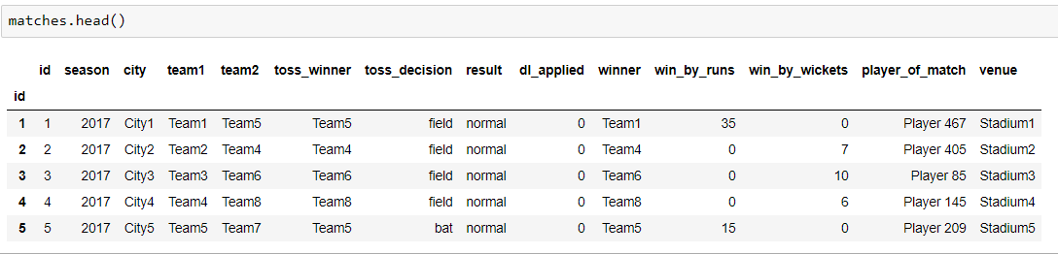
Data
Data was downloaded from www.cricsheets.org and www.espncricinfo.com
Matches dataset contains variables like match_season, venue, team1, team2, toss_winner, toss_decision, result, dl_applied, winner, win_by_runs, win_by_wickets, player_of_match were considered for matches played since Jan 1, 2000
Deliveries dataset contains ball-by-ball outcome for each over: match_id, inning, batting_team, bowling_team, over, ball, batsman, non_striker, bowler, is_super_over, wide_runs, bye_runs, legbye_runs, noball_runs, penalty_runs, batsman_runs, extra_runs, total_runs, player_dismissed, dismissal_kind, fielder

Slide 6
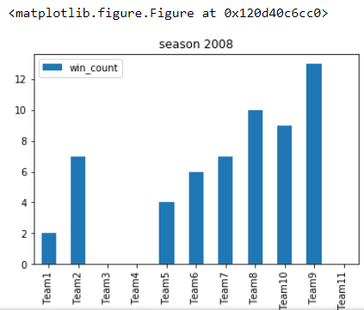
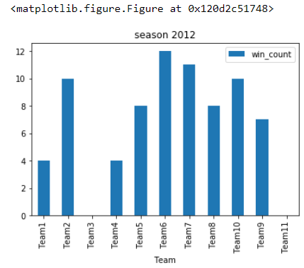
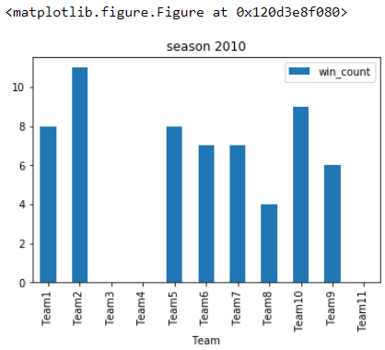
Features – Season (year), Coin toss, Venue
Time is an important feature for predicting match outcome.
Team performance varies per season and hence is an important variable in the prediction model.
In this dataset season feature act as the time period of every match.

Slide 7
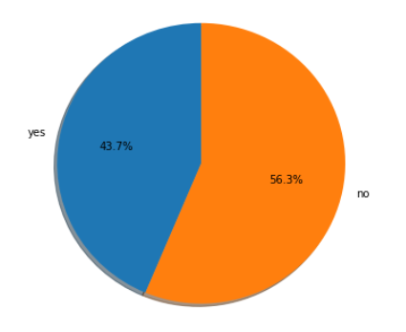
Features – Season (year), Coin toss, Venue
Coin toss - 43.7% of toss winners are also match winners.
Toss winning also act as a major feature in predicting the result
Venue - Home conditions play a very important role in predicting match winners.

Slide 8
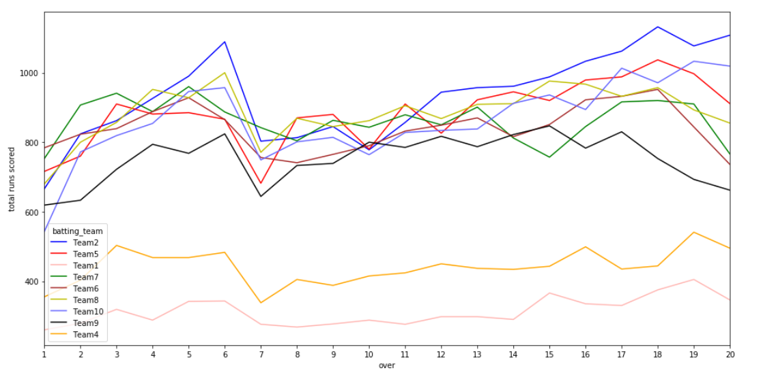
Features – Team performance
We need to come up with measurements for team performance.
Let us look at the runs scored per over across all matches. 1 over = 6 deliveries (pitches)
This isn’t very useful so let us compute team batting and team balling averages

Slide 9
Features – Team performance
The team performance measurements are calculated using the Deliveries dataset
Team_A_batting_average, Team_B_batting_average: Computed using bye_runs, legbye_runs, batsman_runs
Team_A_bowling_average, Team_B_bowling_average: Computed using wide_runs, noball_runs, penalty_runs, extra_runs, total_runs
Team_A_total_runs, Team_B_total_runs

Slide 10
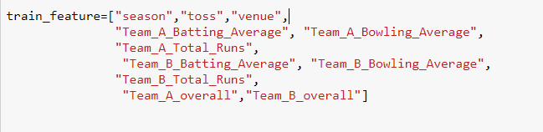
Features:
Target variable:
‘winner’ is our dependant variable and takes values 0 and 1.
Test…train:

Slide 11
Logistic Regression
Logistic regression is generally preferred when there are only two categories of the dependent variable.
Logistic regression fits an S-shaped curve to the data.
This curve relationship ensures that:
The predicted values are always between 0 and 1
and that the predicted values correspond to the probability of Y being 1 (win) or 0 (lose).

Slide 12
Logistic Regression
Assume that team ‘a’ plays a match against the team ‘b’ for the k^{th} time and let p_{abk} be the probability of team ‘a’ winning that match. Then the win-loss odds ratio of that match is:
logit(p_{abk}) = p_{abk} / (1−p_{abk})
Accordingly, the outcomes of such bilateral matches can be modeled by the following logistic regression model:
Ln(p_{abk} / (1 – p_{abk})) = β₀ + β₁TBat_{a} + β₂TBowl_{a} + β₃TRuns_{a} + β₄TOvr_{a} + β₅TBat_{b} + β₆TBowl_{b} + β₇TRuns_{b} + β₈TOvr_{b} + β₉S + β₁₀Toss + β₁₁Venue

Slide 13
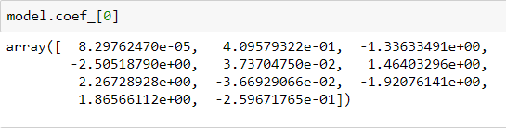

Logistic Regression – coefficients and intercept

Slide 14
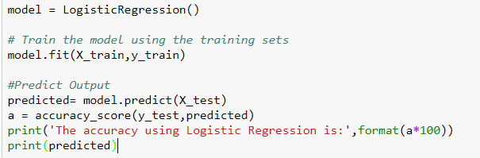
Logistic Regression
The accuracy using Logistic Regression is: 86%

Slide 15
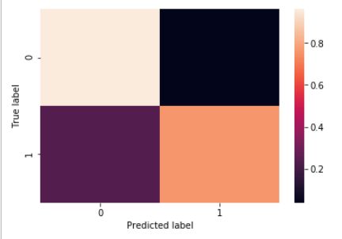
Model Evaluation – Confusion Matrix
[[24 1]
[ 6 19]]

Slide 16
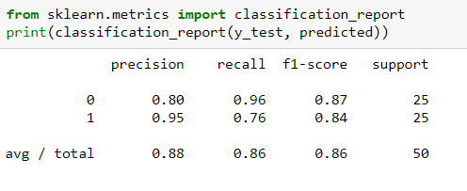
Model Evaluation - Statistics

Slide 17
Model Evaluation - Statistics
Sensitivity: True Positive Rate = TP / (TP + FN) = 24 / 30 = 0.80
Specificity: True Negative Rate = TN / (TN + FP) = 19 / 20 = 0.95
Positive Predictive Value: TP / (TP + FP) = 24 / 25 = 0.96
Negative Predictive Value: TN / (TN + FN) = 19 / 25 = 0.76
Positive Likelihood Ratio: TPR/FPR = Sensitivity / (1 – Specificity)
= 0.80/(1-0.95) = 16:1
Negative Likelihood Ratio: FNR/TNR = (1 - Sensitivity) / Specificity
= (1 – 0.80) / 0.95 = 4:19

Slide 18
Future Model Improvements
This prediction model can be further improved by considering features such as:
Player of the Match (MVP)
Result of Previous Match
ICC Team Ratings
Score of openers
Number of ‘outs’ in the first 10 overs.

Slide 19
The End

